Slide 1

Bitcoin Sentiment Analysis

Slide 2



Team 10 Presentation
Chris Messer
Consultant at Deloitte
Erin Abbott
Business Consultant
Devyn Byrd Comp Sci Grad Student

Slide 3

Agenda
Project Background
Bitcoin
Sentiment Analysis
Hypothesis
Data Preparation
Planned Approach

Slide 4

Project Background
1
What is bitcoin? What is Sentiment Analysis?

Slide 5
Bitcoin
2009 - Bitcoin launch
2011 - Bitcoin reaches $1 USD in market value
2015 - Bloomberg magazine features bitcoin, becomes a mainstream commodity
1
3
5
2
4
6
2010 - First bitcoin transaction - “Pizza Day”
2013 - Bitcoin reaches $1B in market cap
2021 - Bitcoin reaches all time high of $61K
Notes:
Decentralized, monetary system separate from the state (note that 2008 financial crisis was only a year prior to bitcoin launch.) Nobody knows who satoshi actually is. On Pizza day, Laszlo Hanyecz paid 10,000 BTC for pizza (two papa johns pizzas that were worth $25 but would now be worth over $500 million).

Slide 6
Sentiment Analysis
Extract
Tokenize
Analyze
Extract the data we would like to analyze
Twitter Data
Reddit Data
Tokenization in NLP is the process of breaking up text into smaller pieces called tokens. The tokens can then be quantitatively transformed and analyzed
Transform the tokens into quantitative measures using Natural Language Processing and Machine Learning to extract the sentiment of the text
Notes:
Sentiment analysis is a type of natural language processing that is able to interpret and categorize opinions expressed in text. It is used to identify and understand the attitudes, opinions and emotions of people based on text.
Sentiment analysis can be used across a variety of applications, from customer service to product feedback to marketing. For example, Dorritos could measure how their superbowl commercial is perceived in real time by analyzing the “sentiment” of the tweets that have the hashtag #dorritos.

Slide 7
Choosing a Sentiment Model
Different Approaches
Neural Networks
Rule Based
Machine Learning
Hybrid Approaches
Notes:
There are many different approaches to sentiment analysis, from simple rule based approaches to deep learning and recurrent neural networks. To decide on a model, we considered two factors, accuracy of model and consistency with other data sets.
Regarding accuracy of model, we consulted a whitepaper, Social media sentiment analysis for cryptocurrency market that covers accuracy of different sentiment analysis models when trained on crypto currency content across twitter and reddit. The paper found that of 21 models tested, VaderSentement was one of the strong performing models. Because this is the same model used in the twitter data kaggle set, we opted to use this one for the reddit sentiment analysis as well.

Slide 8
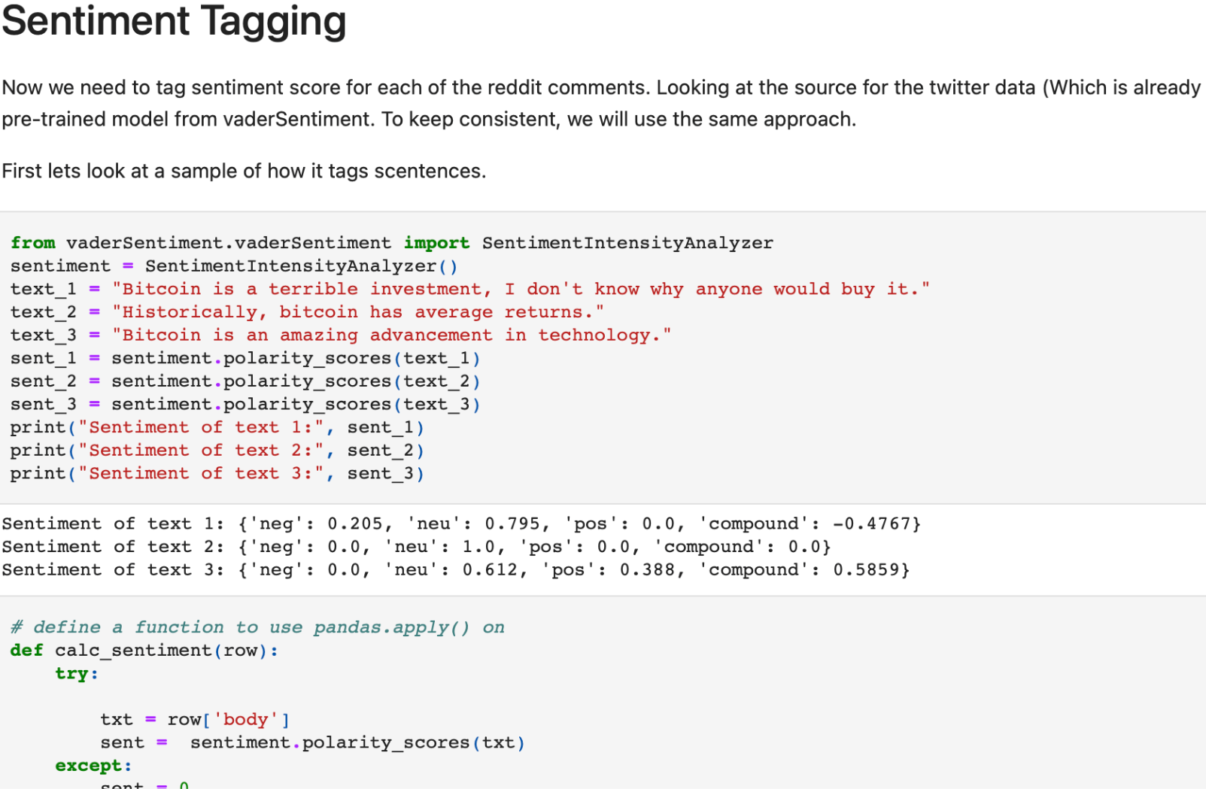
Example
“Bitcoin is a terrible investment, I don't know why anyone would buy it."
—->
Sentiment of text:
{'neg': 0.205,
'neu': 0.795,
'pos': 0.0,
'compound': -0.4767}
Notes:
Here we can see that when you input a sentence the model will return a sentiment score. The sentence “Bitcoin is a terrible investment, I don't know why anyone would buy it." gives a compound score of -.48. Negative 1 implies the sentence is very negative, and positive 1 means very positive. Here we can see the statement leans negative.

Slide 9
Hypothesis
2
How do bitcoin and sentiment around bitcoin correlate?

Slide 10
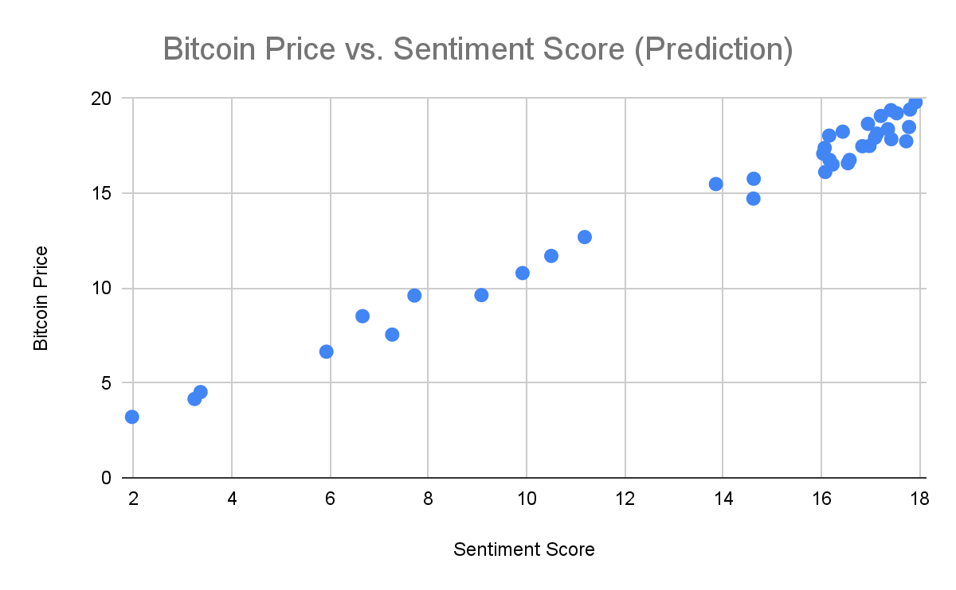
Hypothesis
Positive correlation between sentiment of tweets/posts and Bitcoin price
Notes:
We hypothesize that there will be a positive correlation between the price of bitcoin and the number of positive sentiment tweets/reddit comments about bitcoin, and a negative correlation with the negative sentiment media.

Slide 11
Data Preparation
3
How should we transform the data?

Slide 12
Reddit Sentiment Analysis
Extract
Transform
Tag
Aggregate
The data we will use for this analysis has already been prepared. See sources cited.
Several data transformation steps must occur:
Align the date range
Remove Symbols, URLS, numbers
Language standardization
We will use the VaderSentiment Tagging package, as the it was used in the twitter data set.
Lastly, aggregate the reddit comments at various intervals to use it in the final regression model.
Notes:
To prepare the reddit data from the kaggle dataset,there were a few transformations that need to be done. Firstly, we aligned the reddit comments time frame with the kaggle dataset for the tweets about bitcoin. The twitter dataset contains only tweets from August 2017 to January 2019. And the reddit comments reached all the way back to 2012. Therefore, we trimmed the reddit comment dataset to match the twitter dataset.
Then we cleaned up the text comments, removing special characters, numbers, and non-english comments.
Next, we used the VaderSentiment algorithm to tag the comments with a sentiment score.
Finally, we aggregated the data. The original data was at a per comment bases, and the twitter data was aggregated at hourly intervals. So we summed up the total positive, negative, and neutral comments at each hour, in aggregate, and across different subreddits.

Slide 13
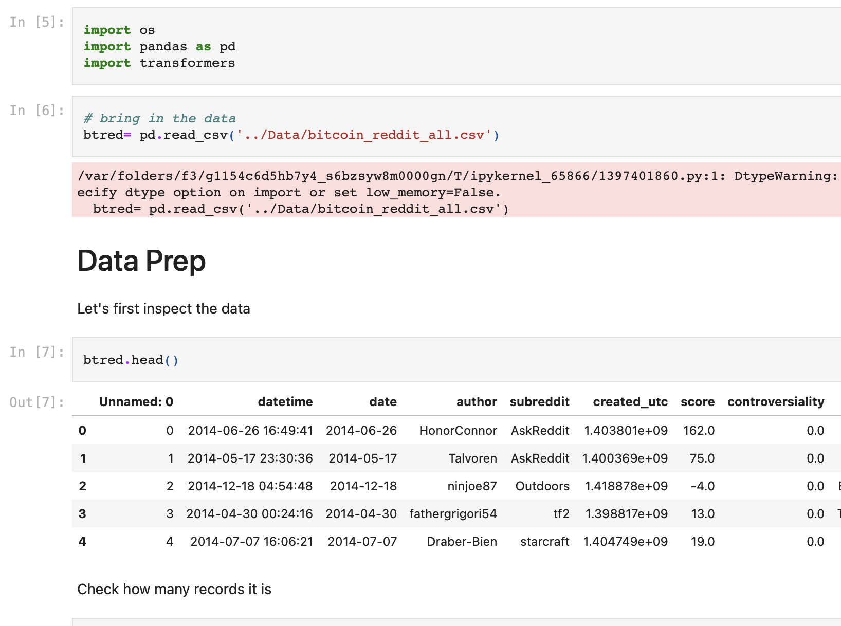
Reddit Sentiment Analysis Results
Jupyter Notebook
Notes:
Here you can find the notebook used to perform all of the sentiment analysis.

Slide 14
Planned Approach
4
What should we do with the data?

Slide 15
Approach
Train
Validate
Test
Model and parameter selection, split the data into train/test/validate sections and train the selected models
Use different models hyperparameters and independent variables to choose the best model
Compare the different models against one another
Notes:
In order to determine whether there is any correlation between sentiment and bitcoin pricing movements, we will need to build several models.

Slide 16
Train
Models
Linear Regression
Logistic Regression
Parameters
Open/close price at t-1
Reddit sentiment at t-1
Aggregate by subreddit?
Twitter sentiment at t-1
Reddit/Twitter content volume
Notes:
We will try two different models. A linear model will be used to determine the price of bitcoin at time t, and a logistic regression model will be used to determine whether the price at time t will be higher at time t than at time t-1.
Some of the parameters we will use are
Open/close price at t-1
Reddit sentiment at t-1
Aggregate by subreddit?
Twitter sentiment at t-1
Reddit/Twitter content volume

Slide 17
Train (contd.)
Train/Validate/Test Split
Time series data
60/20/20 split on time series
Notes:
Since the data we are running the analysis on is a time series set, we cannot split it up into random datasets for training/validation/testing. As such, we will use a split of 60/20/20 in sequential order, with the first 60% of hour intervals being the training data, the next 20% being the validation data, and the next 20% being the test data.

Slide 18
Validate
Evaluation of the models
Linear Regression
Adjusted R^2
Elastic Net Variable Selection
Logistic Regression
ROC & AUC
EN Variable Selection
Hetero Skedacity
Notes:
Now we will need to compare the models against one another. For the linear regression models, we will use the adjusted R^2 of the model to compare to other linear regression models.
For the logistic regression curve, we will use the Receiver operator curve and Area under curve to evaluate models against one another.
For both models, we will examine the statistical significance consistency of the standard deviations to ensure the models we are using are reasonable.

Slide 19
Test
Compare models against one another
How often is each model correct?
How correct was it?
Notes:
Lastly, once models are selected, we will perform a retrospective analysis and compare what percent of time the prediction is correct. I.e. what percent of times that we thought the price would decrease form t-1 to t, did it actually decrease?

Slide 20
Sources
Cambria, E., Das, D., Bandyopadhyay, S., & Feraco, A. (Eds.). (2017). Chapter 1: Affective Computing and Sentiment Analysis. In A Practical Guide to Sentiment Analysis (pp. 1–2). essay, Springer.
Cointelegraph. “How and When Did Bitcoin Start? the Complete Bitcoin History.” Cointelegraph, Cointelegraph, 21 Oct. 2022, https://cointelegraph.com/bitcoin-for-beginners/the-history-of-bitcoin-when-did-bitcoin-start
Farell, Ryan, “An Analysis of the Cryptocurrency Industry” (2015). Wharton Research Scholars. 130. https://repository.upenn.edu/wharton_research_scholars/130
Social media sentiment analysis for cryptocurrency market ... - arxiv. (n.d.). Retrieved March 27, 2023, from https://arxiv.org/pdf/2204.10185

